Slide 1
April 3, 2014
MATH 323
Graph Theory
Cr. 3
Lecture 2
Prof. Dr. Bhadra Man Tuladhar

Slide 2

How Google Works?
Mathematics behind Search Engines

Slide 3


Google is designed to be a scalable search engine. The primary goal is to provide high quality search results over a rapidly growing World Wide Web. Google employs a number of techniques to improve search quality including page rank, anchor text, and proximity information. Furthermore, Google is a complete architecture for gathering web pages, indexing them, and performing search queries over them.

Slide 4


Slide 5
Kathmandu University

Slide 6
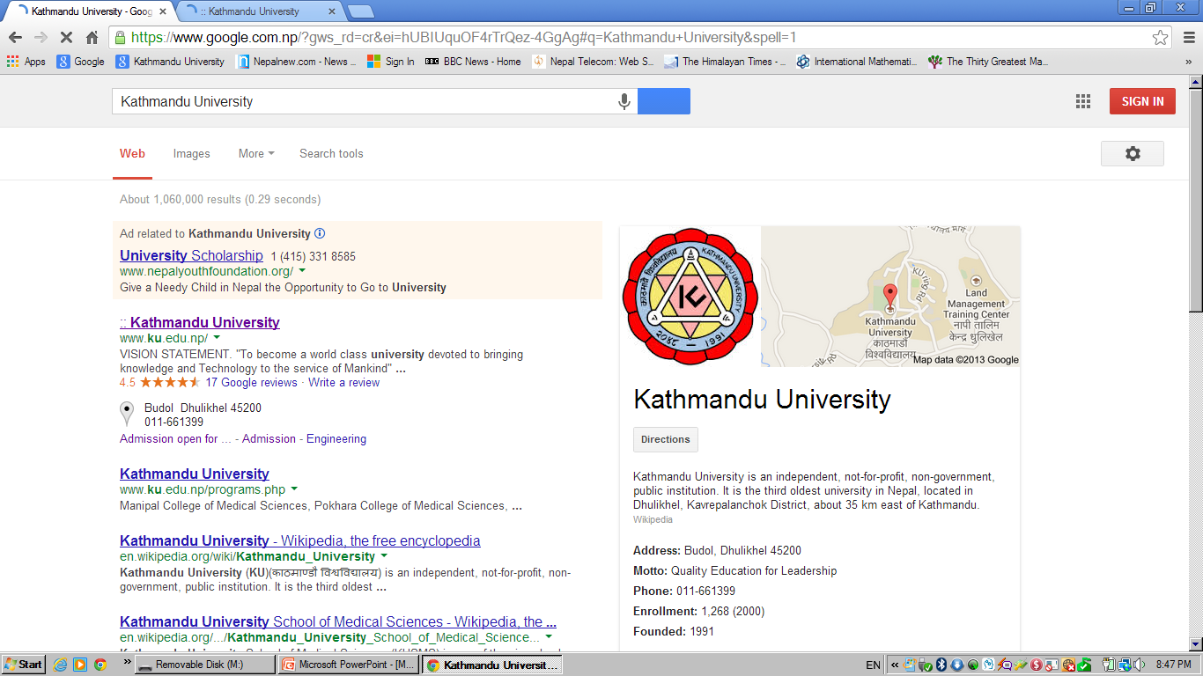

Slide 7


Slide 8


Slide 9


Slide 10

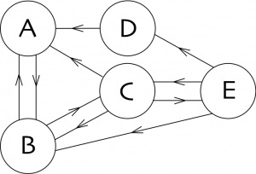
How does it works?
Oriented graph
The vertices are the pages; and the oriented
edges are the links between pages.

Slide 11
How does it works?
Oriented graph
If we are on page A, then there is only one link to page B.

Slide 12
How does it works?
Oriented graph
If we are on page C, there are 3 links, and we can choose to move to either page A, B, or E.

Slide 13
How does it works?
Oriented graph
If we are on page A, then there is only one link to page B.
If we are on page C, there are 3 links, and we can choose to move to either page A, B, or E.
There is at least one link from each page.

Slide 14
How does it works?
Oriented graph
Each page corresponds to a different url (Uniform Resource Locator).
A website may contain many pages.
The above directed graph represents a web of five pages.
This web has 10 links .

Slide 15
More definitions
1. A walk of length k is a sequence v₀, v₁, e₁, v₂, e₂, . . . , e_{k}, v_{k} of vertices and edges such that e_{i} = v_{i-1}v_{i} for all i.
2. A trial is a walk with no repeated edge. (A closed trial which contains at least three edges is called a circuit)
3. A path is a walk with no repeated vertex. The length of a path is the number of edges on the path. A path of length k is denoted as P_{k}.

Slide 16


Some more on Walks
For a walk W : u = u₁ → … → u_{k+1} = v, also W⁻¹ : v = u_{k+1} → . . . → u₁ =u,
is a walk in G, called the inverse walk of W.
(Write u v to say that there is a walk of some length from u to v. And Write u v to say that there is a walk of length k.

Slide 17
Random Walk
Starting from a page, at each step we choose at random a link from the page where we are, and we follow it.
If we start on page B, then we can go to A or to C with probability ½ for each case.

Slide 18
Random Walk
Starting from a page, at each step we choose at random a link from the page where we are, and we follow it.
If we start on page B, then we can go to A or to C with probability ½ for each case.

Slide 19
Random Walk
If we start on D, then we necessarily go to A with probability 1.
We iterate the game
Where will we be after n steps?

Slide 20
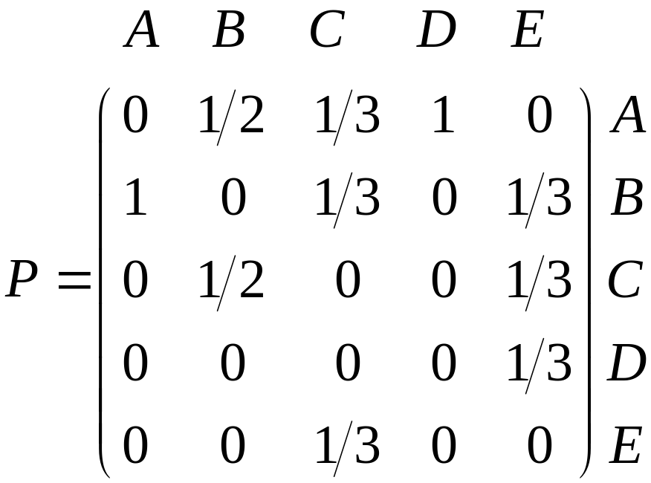
Random Walk
We summarize the web in the following matrix P.
Each column represents the departing page.
Each row represents the page where we arrive.

Slide 21

Random Walk
Sum of entries of any column of P is equal to 1.
All entries are greater or equal to zero.
Matrices having these two properties are matrix of a Markov chain process. (Markov transition matrix)

Slide 22
Random Walk
It always has as an eigenvalue1.
There exists an eigenvector with eigenvalue 1, all the components of which are less than or equal to 1 and greater than or equal to 0, with sum equal to 1.

Slide 23
More definitions
4. A cycle is a closed trial in which “first = last” is the only vertex repetition. The length of a cycle is the number of edges on the cycle. (A loop is a cycle of length one). A cycle of length k is denoted as C_{k} (k-cycle).
If k is even(odd), we say that the path or cycle is even(odd).

Slide 24
Exercise
For the given figure, answer the following:
Find paths of length 3, 4, 5, 6.
Find cycles of length 3, 4, 5, 6, 7.
Find all possible trials form a to e.
a
c
b
d
e
f
g

Slide 25
More definitions
5. A graph is connected if every pair of vertices can be joined by a path, otherwise it is disconnected.
6. Each maximal connected piece of a graph is called a connected component.

Slide 26
More definitions
7. If the removal of a vertex v from G causes the number of components to increase, then v is called a cut-vertex.
8. If the removal of an edge e from G causes the number of components to increase, then e is called a cut-edge or bridge.

Slide 27
More on Subgraph
Let v be a vertex of graph G containing at least two vertices. Then the graph G - v is the subgraph of G, whose vertex set consists of all vertices of G except v and whose edge set consisting of all edges of G except those incident with v.
In this example v is a cut-vertex.
v
G - v
G

Slide 28
More on Subgraph
Let e be an edge of a graph G, then G – e is the subgraph of G consisting of the same vertex set as of G and having all edges of G except e.
e
Here e is a bridge.
G - e
G

Slide 29

NEXT
Graph (contd.)
Trees

